Slide 1
Agile Primer for BADS Team

Slide 2
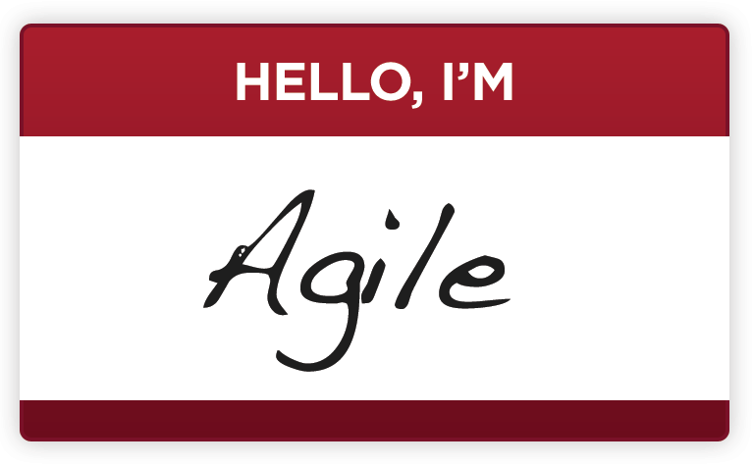

What is Agile?
Don’t just “Do” Agile…Strive to “Be” Agile
Agile means many thing to many people…it’s important to look at Agile in terms of principles, practices, and processes
There is no one-size-fits-all plan for being Agile…the approach taken depends on organizational culture, type of project, existing team structures and skillsets and many other factors
Agile is NOT about….
NO Process, NO Documentation
Coding to the last minute – “death marches”
Trading short-term gains for long-term problems
p 2
Notes:
Being Agile is characterized by you Personal Commitment and being highly collaborative with your team and stakeholders.
Agile values PEOPLE over processes.
Some consider Agile to be process intensive because of the number of ceremonies, planning sessions, etc. This is because Agile is HIGHLY Collaborative.
Discipline to the process is important – we need to stick to the process 98% of the time. When we do not, we need to be VERY INTENTIONAL and OVER COMMUNICATE
Documentation gets done as part of the work. We include documentation in the Definition of Done and/or Acceptance Criteria.
The goal is to keep a steady pace of work for all on the team(s) so that we can be reliable and consistently deliver.
Work is iterative and builds on itself. This may mean we re-work things as we get to later sprints and stories.
Scrum Values
All work performed in Scrum needs a set of values as the foundation for the team's processes and interactions. And by embracing these five values, the team makes them even more instrumental to its health and success.
Focus
Because we focus on only a few things at a time, we work well together and produce excellent work. We deliver valuable items sooner.
Courage
Because we work as a team, we feel supported and have more resources at our disposal. This gives us the courage to undertake greater challenges.
Openness
As we work together, we express how we're doing, what's in our way, and our concerns so they can be addressed.
Commitment
Because we have great control over our own destiny, we are more committed to success.
Respect
As we work together, sharing successes and failures, we come to respect each other and to help each other become worthy of respect.

Slide 3
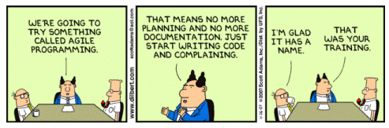
What is Agile?
NOT!
p 3

Slide 4
What is Agile?
“Agile” is most often associated with “doing” software development...
Definition¹:
Agile software development is a group of software development methods based on iterative and incremental development, where requirements and solutions evolve through collaboration between self-organizing, cross-functional teams. It promotes adaptive planning, evolutionary development and delivery, a time-boxed iterative approach, and encourages rapid and flexible response to change. It is a conceptual framework that promotes foreseen interactions throughout the development cycle. The Agile Manifesto introduced the term in 2001.
Laymen’s terms:
Requirements evolve through discussions
Work is best done in time-boxed iterations (design, coding and testing all in the same iteration)
New requirements are incorporated in follow-on sprints along the way
Deliver business value early and often
Fail early and often
….but “being” Agile is about organizational principles
Agile Organizations
Embrace the need to react to rapidly changing conditions through short release cycles
Understand “business value” of features and can regularly prioritize work based on this
Understand the value in releasing something that is “good enough”
Value open and honest communication and feedback
p 4
¹Source: Wikipedia

Slide 5
What is Agile Development?
Agile Development is best described as an umbrella term that encompasses 3 areas..
PRINCIPLES¹
We are uncovering better ways of developing software by doing it and helping others do it. Through this work we have come to value:
Individuals and interactions over processes and tools Working software over comprehensive documentation Customer collaboration over contract negotiation Responding to change over following a plan
That is, while there is value in the items on the right, we value the items on the left more.
PRACTICES
Extreme Programming (XP) Feature Driven Development
Paired Programming Automated Testing
Test Driven Development (TDD) Continuous Integration/ Continuous Builds
PROCESSES
Scrum
Kanban
p 5
¹Source: www.agilemanifesto.org
Notes:
May require a bit of a shift in thinking:
People over process
Usable features over documentation which is stale pretty quickly
We don’t know everything before we begin. We find out along the way working with our customers.
Not only will the business needs change frequently the longer your project is, yet you learn more from what you have accomplished that can change the needs and priorities.
We will have to be comfortable with uncertainty yet be able to work with it.

Slide 6
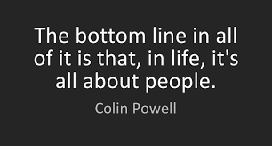
What is Agile Development?
p 6
Notes:
May require a bit of a shift in thinking:
People over process
Usable features over documentation which is stale pretty quickly
We don’t know everything before we begin. We find out along the way working with our customers.
Not only will the business needs change frequently the longer your project is, yet you learn more from what you have accomplished that can change the needs and priorities.
We will have to be comfortable with uncertainty yet be able to work with it.

Slide 7
How is Agile Development Different?
Traditional SDLC (Waterfall)
Structured / Predictable
Linear
Extensive Pre-Planning
Progress measured in terms of deliverables, artifacts, documentation, and specifications
Requirements
Design
Code
Test
Release
Agile
Adaptable
Iterative / Cyclical
Planning “Just in Time”
Progress measured by working software
Possible Release
Possible Release
Possible Release
Iteration 1
Iteration 2
Iteration 3
Business Request
Stories
Stories
Stories
p 7
Notes:
The big difference is that Waterfall takes a long time before we demonstrate any REAL results in working software.
Agile we deliver results often where our customers see working software. It might not have all the features they requested yet – but what we do have works.
We do all the same types of activities – just in smaller chunks
The sprint is meant to keep us perpetually focused on what we need to deliver NOW.
We focus ONLY on the most valuable items NOW. – this means we try to spend as little of our time thinking about, talking about, writing about, estimating, etc. anything that is not the most important work to be completed NOW – and that is the work in the active sprint.

Slide 8
What is Scrum?
It is a “framework” that:
Provides clear roles and responsibilities
Provides mechanism for making problems (technology and people) apparent early
Depends on adaptive behavior
Self-organizing, self-managing, inter-disciplinary teams
No single point of control
Suitable for Project (has a begin and end) type of work.
Designed to embrace and transcend contradictions
Requirements are not fully understood before a project begins
Users know what they want only after they see an initial version of the software
Requirements change often during the software construction process
New tools and technologies make implementation strategies unpredictable
SOURCE: 1/22/2007 Copyright 2003-2006, ADM and Jeff Sutherland, v6.3.5
Core Tenets
Deliver working software frequently and iteratively
Self-managed teams are more productive.
Promotes transparency and visibility
Expose roadblocks early providing the most amount of time to correct the problems.
Quality is not to be compromised.
Inspect and Adapt - Teams get the chance to continuously improve
p 8

Slide 9
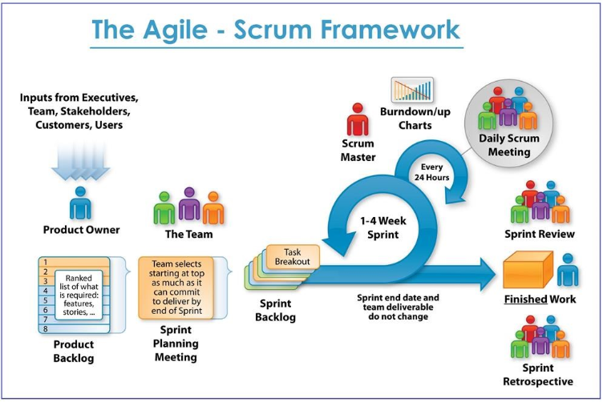
Scrum Lifecycle
http://www.etechpulse.com/2015/02/agile-scrum-process-sdlc.html
p 9
Notes:
Watch Video of Scrum in 10:
https://www.youtube.com/watch?v=XU0llRltyFM
Scrum Alliance:
https://www.youtube.com/watch?v=TRcReyRYIMg
Scrum v. Kanban:
https://www.youtube.com/watch?v=rIaz-l1Kf8w

Slide 10
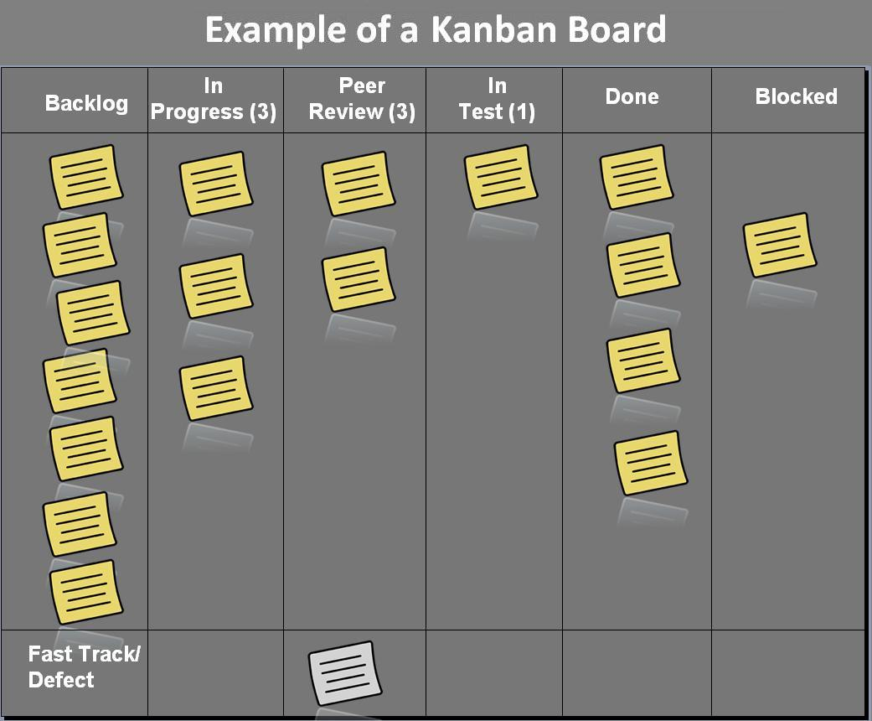
What is Kanban?
A method for developing software with an emphasis on just-in-time delivery:
Utilizes a queue/pipeline based system to pull and deliver work.
Uses a visual approach (Kanban board) to determine what work to be done vs. in progress vs. completed.
Is designed to limit Work In Process (WIP) at various stages in the lifecycle
Suitable for managing support related activities or work that never ends…
p 10

Slide 11
Scrum vs. Kanban
Area | Scrum | Kanban
Timeframe | 2 – 4 weeks Sprints/Iterations | Not time boxed…on-going
Work measurements | Velocity | Measures Work In Process (WIP) across each stage
New Work Started | At the beginning of each iteration | As needed based on WIP limits
Roles and Responsibilities | Prescribed roles/responsibilities | No prescribed roles/responsibilities
Inspect and Adapt | At the end of each Sprint | On-going as needed
Works well for | Complex Product Development | Production Support Rapid prototyping for new products
p 11

Slide 12
Considerations if moving from Waterfall to Agile
Area | Considerations
Organizational Impacts and Considerations | Reasons for moving to Agile Top down or grassroots efforts Organizational Expectation Setting and Readiness Demystifying Agile as a “silver bullet” Moving to “agile” is a journey (e.g. marathon not a sprint) Culture - “Continuous Learning / Kaizen” vs. “Command and Control”
Right approach for the right projects | What types of projects exist today Product Development/Custom Applications, Vendor Software Implementation, Product Maintenance Picking the right framework for the right project (Scrum, Kanban, SDLC/Waterfall) Impacts to non-technology organizations (e.g. Business Partners – HR, Finance, Sales, Marketing, Customer Support, etc.) Picking pilot project(s)
Team Structure | Dedicated teams vs. partially dedicated teams Distributed vs. co-located teams Transition to new roles and responsibilities (e.g. Project Manager vs. Scrum Master vs. Product Owner) Determining the right people for the right roles Determining the appropriate team makeup and size
Training | Certified Scrum Master and Certified Product Owner courses Books (User Stories Applied, Agile Software Development, Waterfall to Agile, others)
p 12

Slide 13
Waterfall to Agile
What are the considerations when moving from Waterfall to Agile?
Area | Considerations
Execution | Sprint Lengths, Release timeframes Definition of Done Artifacts User Stories, Acceptance Criteria, Features, Epics, Sprint Backlogs, Product Backlogs, Release Plans, etc. Stakeholder Communication / Information Radiators Velocity, Sprint Burn Down Charts, Release Burn Down Charts, Business Value Burn up Charts, etc. Demonstrations Managing Team T-shirt Sizing, Story Pointing, Time estimating, Time Tracking Research Spikes Engineering Practices Test Driven Development (TDD) Continuous Integration Automated Testing
Scaling Agile | Developing Agile “Centers of Excellence” (COE) Hands-on coaching to agile teams Multiple scrum teams and Scrum-of-Scrums Scaled Agile Framework – SAFe
p 13
Notes:
After your team is happy with how you are proceeding with your Agile Project Delivery Process, you will want to look into how you could scale it in a wider area of your organization. Examples include pulling in Dev-Ops, QA, etc. Some of this will happen naturally as you work with other teams and they see your ability to execute and deliver. Other times, you will need to be more forward thinking – usually as you migrate the thinking out to all delivery and how the organization prioritizes as a whole.

